Slide 1

Course Name: Hardware Security
Faculty Name: Prof Debdeep Mukhopadhyay
Department : Computer Science and Engineering
Topic
Lecture 7: Hardware Design for Finite Field Inverse

Slide 2

Concepts Covered:
Hardware Design of Itoh-Tsujii
Performance of the Hardware Circuit

Slide 3
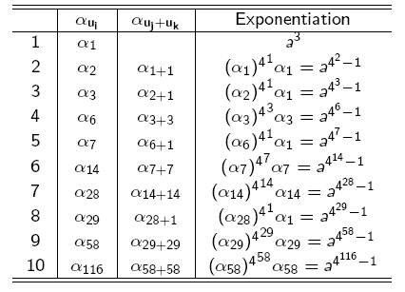
Quad Itoh Tsujii Algorithm
Initial Pre-computation:
To compute the cube, the multiplier is used for 2 clock cycles. Remember there is no squarer.
Likewise, the final squaring also is done by a multiplication step.
So, in total 12 multiplications.
We set n=2
We now require 115 quads (instead of 232) and 9 multiplications. We save 7 clock cycles.

Slide 4
Estimating the number of clock cycles
#Multiplications: l-2+3=l+1. Note that 2 multiplications are needed initially for pre-computation, and one for final squaring.
Difference in clock cycle:
This can be as high as (m-1)/2 for GF(2^{m})

Slide 5
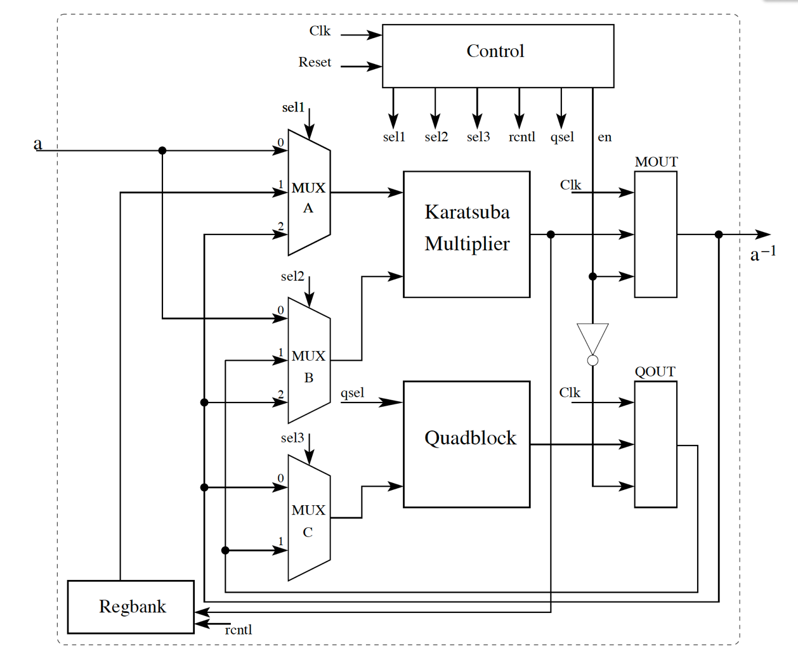
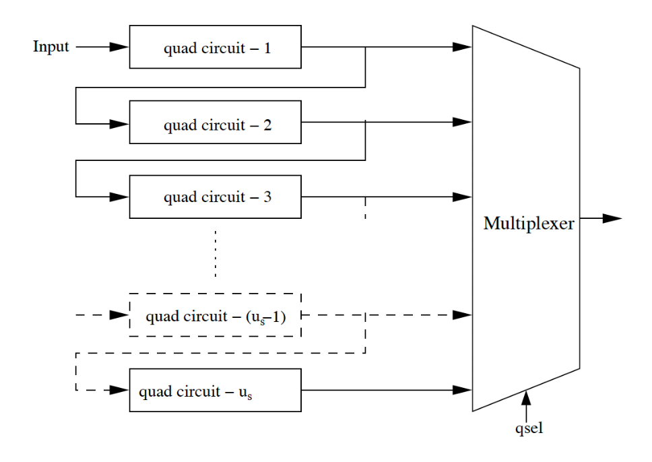
Hardware Architecture for Quad ITA

Slide 6
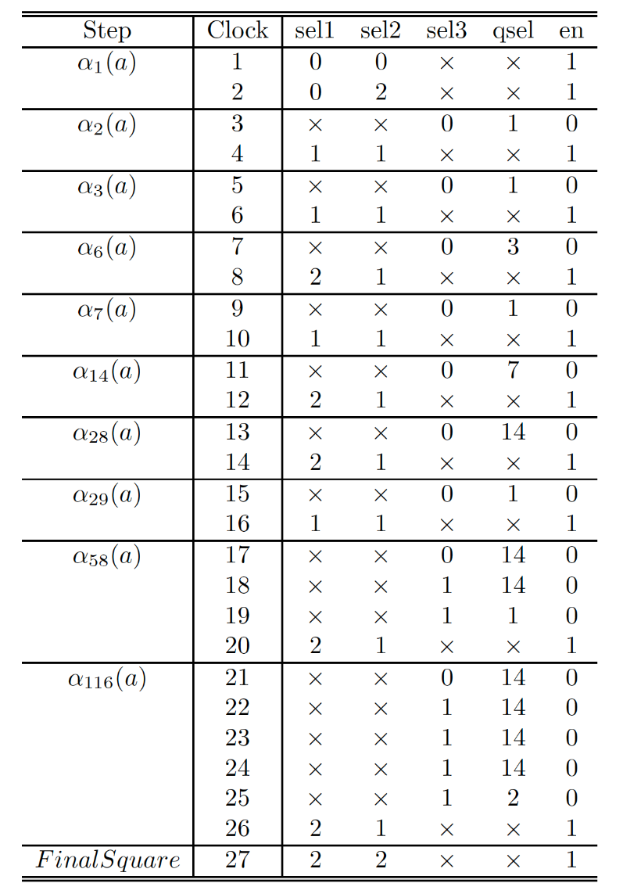
Control Word Design

Slide 7
Number of Cascades
Number of quad circuits (u_{s}) has an influence on the clock-cycles, frequency, and area requirements.
Decreasing u_{s} would reduce area, but also increase clock cycles.
Let a quad circuit require l_{p} LUTs and have a combinational delay of t_{p}.
A cascade of u_{s} quad circuits would require u_{s}. l_{p} LUTs and have a delay of u_{s}. t_{p} .
In order that the quadblock does not alter the frequency of operation u_{s} should be selected such that u_{s}. t_{p} is less than the critical path, which is of the multiplier circuit.
So, we make u_{s}. t_{p} close to the multiplier delay.

Slide 8
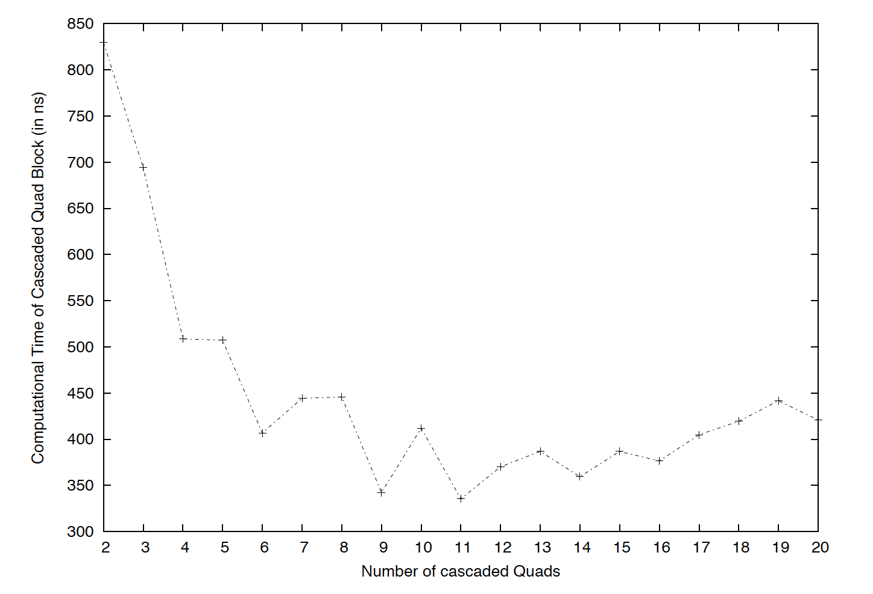
Number of Cascades
Experiments on Virtex-4 FPGA for GF(2²³³)

Slide 9
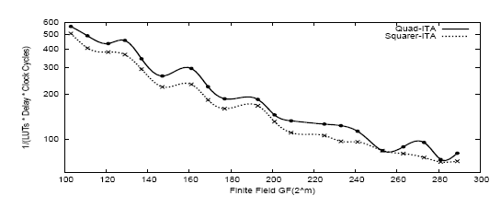
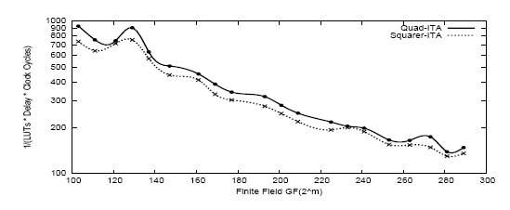
Performance of Quad-ItohTsujii on Virtex 4 and 5 Platforms
Virtex 4
Quad ITA
Squarer ITA
C. Rebeiro et. al. Revisiting the Itoh-Tsujii Inversion Algorithm for FPGA Platforms, IEEE TVLSI
Performance=Frequency/(Slices x ClockCycles)
Virtex 5

Slide 10
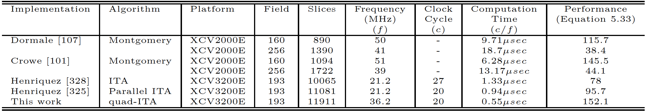
Performance of Inversion Hardware on Xilinx Virtex E

Slide 11


Slide 12
Conclusion:
We studied a very important finite field operations in characteristic 2:
Finite Field Inverse
Itoh-Tsujii Inversion Algorithm
Generalization
Hardware Design of finite Field Inverse

Slide 13


